Slide 1
ASTROPHOTOGRAPHY

Slide 2
Backstory
Astronomy course in college
Started reading books on astronomy
Subscribed to Astronomy magazine for 7 years
Purchased a telescope around 1980
Celestron Schmidt-Cassegrain 8” with tripod
and motorized tracking
First attempt at astrophotography with SLR
Kodachrome iso 400 slide film

Slide 3
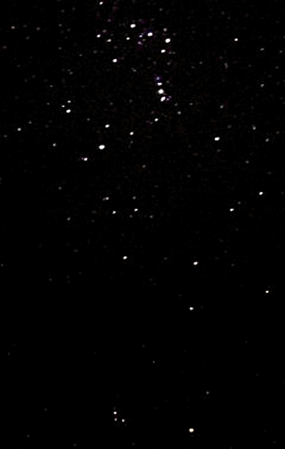
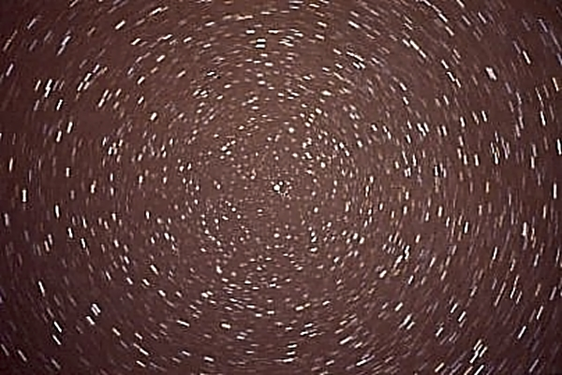
Slides from 1980

Slide 4
Planning
Location
What are going to shoot? (Moon, Milky Way, Stars, etc)
Where is the moon and what phase is it?
What do you have for foreground interest?
Are you going to light paint?
Is the foreground complementing the sky or vice versa?
Will it be a composite image?
You will need clear, dark skies for best star/Milky Way photos
A low dew point with quiet air (no twinkling)
Consider scouting your location in the daytime!!!

Slide 5
Time of Year
Fall and winter have the best skies and longer nights, but colder!! (Batteries will run down faster – have extras)
Milky Way is best viewed in the summer
Summer sunrise means getting up early
Mostly for moon photos
Summer star shots means staying up later
Planning apps
Photopills, dark sky finder, stellarium, photographer’s ephemeris

Slide 6
Photopills screenshot

Slide 7
Equipment
Skies are dark! – you want the most light to get to the sensor, and a sensor that is most sensitive
Full frame camera
Nikon 810A – more sensitive to certain wavelengths and larger battery (3000+ shots)
Wide angle lens – 2.8 or better
Can shoot with crop sensor with “OK” results
My photos are “OK” with crop sensor and 3.5 max aperture

Slide 8
Tripod is a must
Cable release ( I used a 2 sec delay and live view)
Mirror lock-up generally considered unnecessary
Flashlight to see what you are doing and light painting
Red flashlight will preserve your night vision adaptation – some found a head borne light better to keep hands free
Intervalometer for stacking and time lapse
I found the articulating LCD very helpful when shooting straight up!!
Equatorial mount with tracking motor (deep sky)

Slide 9
Shooting tips
Viewfinder and LCD are practically useless for focusing
Options:
Focus to infinity on lens barrel
Focus to infinity during daytime and tape the lens
Use center focus on the brightest star you can find, magnify view on LCD and manually focus; star is better than a planet because it is a pinpoint versus a disc
Use a bright flashlight on a distant object to focus
Bahtinov mask
Hyperfocal distance not recommended unless needed for foreground – relying on depth of field rather than true focus
Take a test photo for exposure/composition/focus (zoom in)

Slide 10
Remove all filters
Use raw or raw+jpeg
Exposure to manual
Turn off image stabilization
Set aperture to its widest, although some recommend backing off a bit on the 1.4 because of aberrations
White balance to 3600 or desired
(I started with AWB and changed it in post processing)
Set iso to 1600 and vary for bright or dimmer image
Turn down LCD brightness to better simulate computer
Check for dew on the lens!

Slide 11
500 Rule
Guideline for exposure settings for sharp star photos
Earth revolves 15 degrees / hour (360 degrees/24 hours)
How long can your exposure be before blur occurs
500 divided by focal length = exposure in seconds
500/25 mm focal length = 20 seconds (full frame)
Use 300 for crop sensor
I used 300/18 mm (widest angle) = 16.66 (15 seconds on my camera)
Caveat: you can increase exposure when closer to the north or south polar axis

Slide 12
Stars as Points of Light
Use 500/300 rule to start
Longer exposure will reveal more stars
Shorter duration for constellations?
Turn off long exposure noise reduction (?hot pixels)
Image stabilization off; suggested shutter speeds:
Full frame Crop sensor
14 mm at 30 seconds 10 mm at 25 seconds
16 mm at 25 seconds 16 mm at 20 seconds
24 mm at 20 seconds 22 mm at 15 seconds
35 mm at 15 seconds
If movement at these speeds, go next faster speed

Slide 13
4 seconds ; f/3.5, iso 1600 at 18 mm

Slide 14
15 seconds ; f/3.5 iso 1600 at 18 mm

Slide 15
30 seconds ; /3.5 iso 1600 at 18 mm

Slide 16
Star Trails
Single exposure – long exposure noise reduction on?
You can use lower iso and less aperture
Use bulb for desired exposure time
Creates circles around north star (Polaris)
Creates lines away from pole
Stacked exposures
Long exposure noise reduction off
Use intervalometer – as many exposures as you want (100+?)
Take 30 second – 4 minute exposures for full circle trails
Sky stacker program: Starstax (freeware)

Slide 17
Example exposure times for singular star trails (no moon)
Time F-stop iso
32 minutes f/4 400
64 minutes f/4 200
2 hours, 8 minutes f/5.6 200
4 hours, 16 minutes f/5.6 100
or f/8 200

Slide 18
Example exposure times for stacked star trails (no moon)
Exposure Time F-stop iso
30 sec to 4 minutes f/2.8 400 – 800
With 4 minute exposures, 45 minutes with a 50 mm lens is a good starting point (11-15 exposures)
With 30 second exposures, you may have hundreds
The most I encountered in research was 1000 which took 8 hours!

Slide 19
Unedited jpg: 15 minutes ; f/ 3.5, iso 400 at 18 mm

Slide 20
Edited: 15 minutes ; f /3.5, iso 400 at 18 mm

Slide 21
Unedited jpg: 15 minutes ; f/ 3.5, iso 400 at 18 mm

Slide 22
Edited: 15 minutes ; f/ 3.5, iso 400 at 18 mm

Slide 23
Single trail: f/5.6, iso 100 at 16 mm; 2 hours 8 minutes

Slide 24
Stacked trail: f/2.8, iso 6400 at 12 mm; 25 sec each

Slide 25
Stacked trail: unknown parameters

Slide 26
Stacked trail: 64 exposures, f/2.8, iso 400 at 16 mm; 4 min each

Slide 27
Milky Way photography
Current position – southern sky with galactic center near the horizon
Basically same settings as stars as points of light
Many photos are composites – one for the sky, one for land
Land photo is lower iso with extended exposure to capture more detail with sharpness and smooth water
Combine images in software
Or use light painting at a lower iso for the foreground
Better to shine the light from a side angle from a distance for better depth to the lighting – lots of trial and error!

Slide 28
unedited raw Milky Way: f/3.5, iso 1600 at 18 mm

Slide 29
Edited Milky Way: f/3.5, iso 1600 at 18 mm (temp 3825)

Slide 30
Edited Milky Way: f/3.5, iso 1600 at 18 mm (temp 3000)

Slide 31
Milky Way: f/1.4, iso 1600 at 24 mm 20 seconds – Yosemite Canon 5D

Slide 32
Milky Way: f/1.8, iso 2500 at 24 mm 20 seconds – Zion, Canon 5D – 5 image panorama

Slide 33
Milky Way: f/2.8, iso 6400 at 15 mm 25 seconds – Bryce, Canon 5D – light painting

Slide 34
Moon photography
Very bright – can almost start with daylight settings
Start with f/8, iso 100 and shutter 1/125 – 1/60
Best to try shooting the moon a day or two before full or a day or two after full at sunrise
Full moon means sun is/has set and foreground is dark
Almost full moon “looks” full
Thin crescent moon will illuminate foreground and still can get the stars to show on photos
Try photographing landscape by moonlight!

Slide 35
Moon during lunar eclipse – January 2019 (-8 degrees!)

Slide 36
Moon during total lunar eclipse – January 2019 (started to snow!)

Slide 37
Waxing Crescent Moon – August 4, 2019

Slide 38
Supermoon – Nov 2016; Canon sx10, iso 400 f/5.7 1/250 sec 560 mm focal length equivalent; edited in ON1 from jpg

Slide 39
Full Moon

Slide 40
“Almost” Full Moon with Alpenglow

Slide 41
Crescent Moon at Sunrise

Slide 42
Meteors
Use star as points settings
Point camera near or at origination point
Set up intervalometer to take sequential frames
Bound to get something in one of the frames!
Perseids coming this month (Aug 12-13) but there will be an almost full moon at that time
Start looking/shooting now after moon sets and may get lucky
Look to the northeast low to mid sky

Slide 43
Meteor with Milky Way

Slide 44
Iridium Flares or Glints
Refers to any reflective object in the sky that isn’t natural
Name comes from early satellites made with iridium
Includes satellites and planes, etc.

Slide 45
Satellite glint

Slide 46
Surprise!

Slide 47
Is it a plane?

Slide 48
Yes, it’s a plane!

Slide 49
Post processing
Hot pixels
With long exposures, the sensor pixels are receiving a lot of light and data and can heat up, causing them to glow brightly
Can show up as red, blue or green dots in your photos
Long exposure noise reduction will help remove them, but requires a second “dark frame” exposure
I discovered that ON1 removes them when photos are exported
I had to crop this jpg with another program to avoid removal

Slide 50
Hot pixels

Slide 51
Processing Adjustments
Image on computer will be darker than the LCD image
Several videos available on post processing night sky photos, but there isn’t a consistent work flow, just like with normal photos
I used some of the normal sliders in tone and color, as well as a “bit” of dynamic contrast, sharpening and cooler color temperature; I exported using the “screen” option

Slide 52
Processing Adjustments
Other recommendations for adjustments are:
Exposure
Contrast
Clarity – Makes the stars pop, but makes them appear larger
Shadows
Whites
Blacks
Vibrance
Saturation
Sunshine!! – makes the brights brighter and darks darker?

Slide 53
Processing Adjustments
Most of the images I reviewed in the videos started out with an image 10x better than mine and their recommendations didn’t achieve the results that they did
In the end, make the image pleasing to you!

Slide 54
Software and Resources
Starstax - freeware
Star Tools - $50
Nebulosity - $95
Nik Collection - free plug in for PS and Lightroom
References:
Night Sky Photography by Jennifer Wu and James Martin
Teach yourself Astrophotography – ebook through Future publishing (also in print)

