Slide 1
Intro to Levels and Curves
Photoshop

Slide 2
Levels and Curves
If you want to modify the tonal range of your image—for example, by making the shadows or highlights brighter or darker—you can adjust the levels or curves.
Tonal Range, 0 – 255: The measure of brightness from complete dark to complete light. The range between the different brightness levels within our photos determines its degree of contrast. Applies to color and B/W images.

Slide 3
Why is Tonal Range Important?
Enhance contrast
Darks are darker
Brights are brighter
Reveals detail
Reveals all possible shades of color

Slide 4
Levels
Every image has a mix of shadows, highlights, and midtones. Shadows are the darkest parts of the image, highlights are the brightest parts, and midtones are everything in between.
When you adjust levels, you're adjusting these different tones.
And while you could use the brightness and contrast tools for a similar type of adjustment, they're much less powerful than levels.

Slide 5
What is Black Point, White Point
Black point is a relatively small area that is pure black (0)
White point is the area that is pure white (255)
What about the gray point?

Slide 6
Adjustment Layers
Adjustment layers are a type of nondestructive editing because they don't actually change anything about the original image. And because you can continue to tweak adjustment layers as you work, it's easy to try out different effects and get the image to look exactly the way you want.

Slide 7
To Access Levels
Click the Adjustment Layer icon
To reveal Adjustment layers, select Levels
As an alternative, Ctrl J to duplicate selected layer, Ctrl L

Slide 8
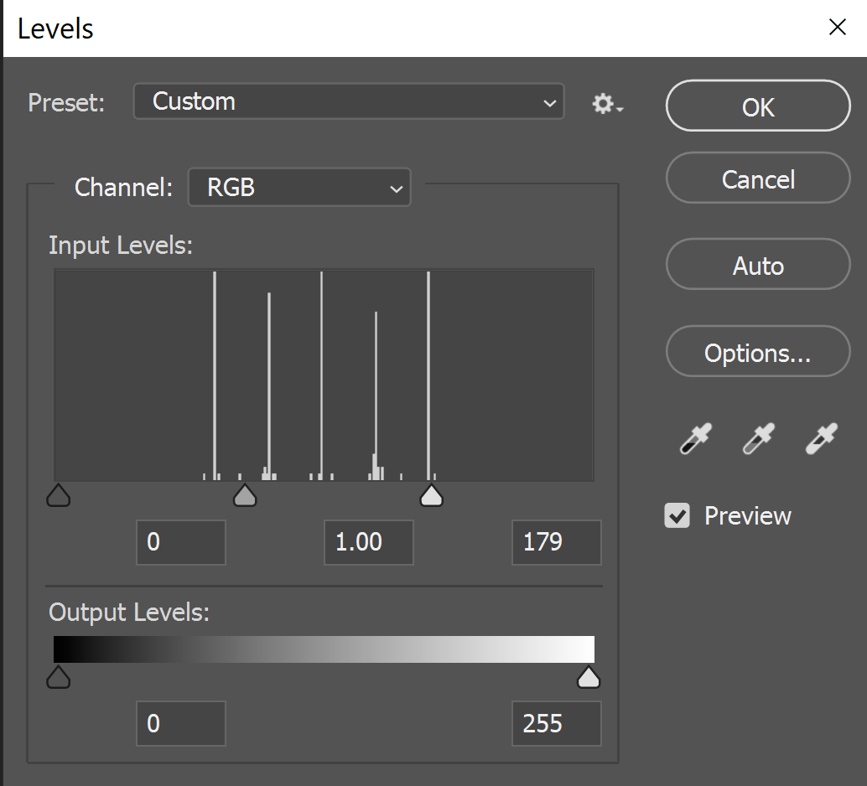
Adjusting Levels

Slide 9
Curves RGB, Red, Green, Blue Channel
Targeted Adjustment Tool
Black(0) Shadows MidTone(128) Highlights White(255) * Where else have you seen these tones as sliders?

Slide 10
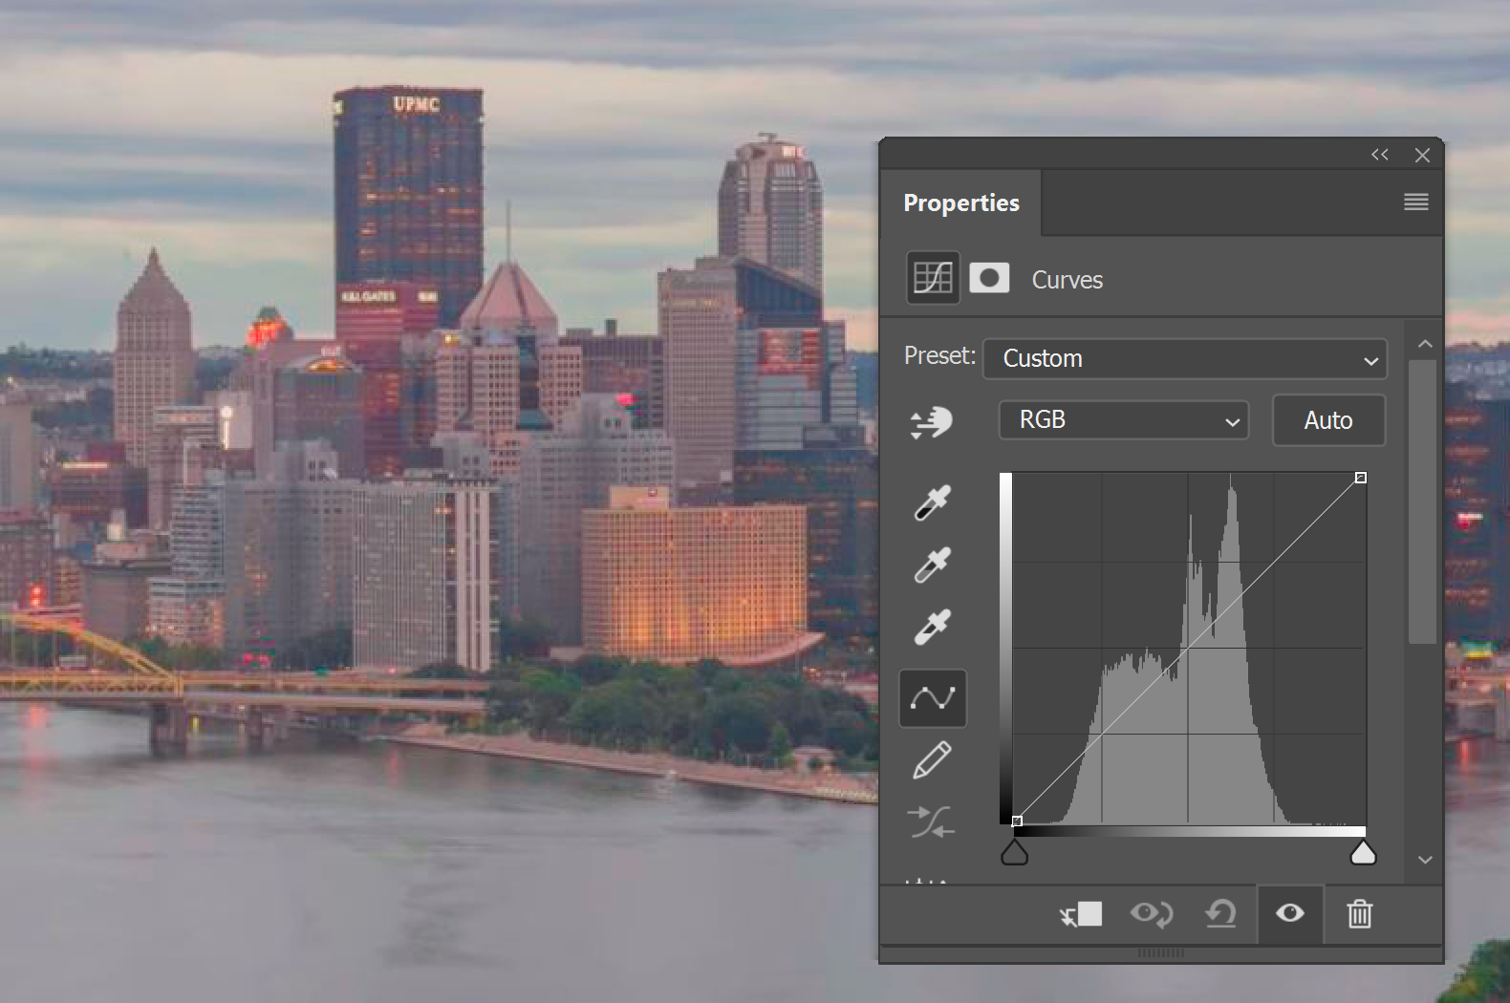
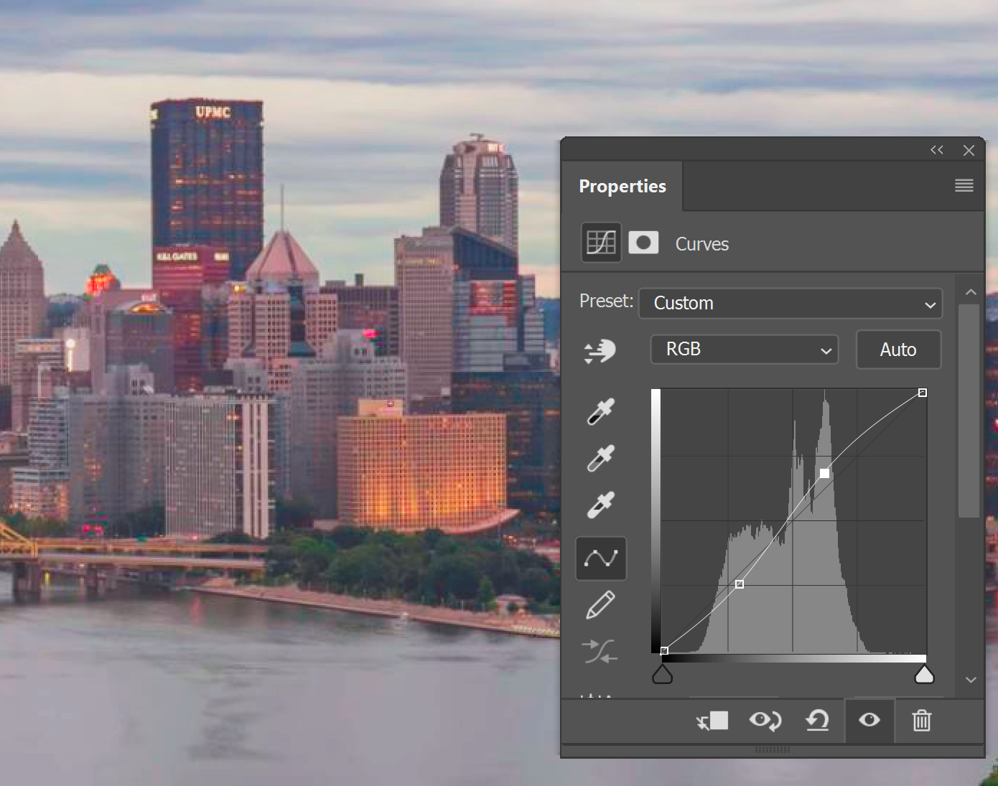
S Curve
Adds contrast
Darkens the shadows
Brightens the highlights

Slide 11
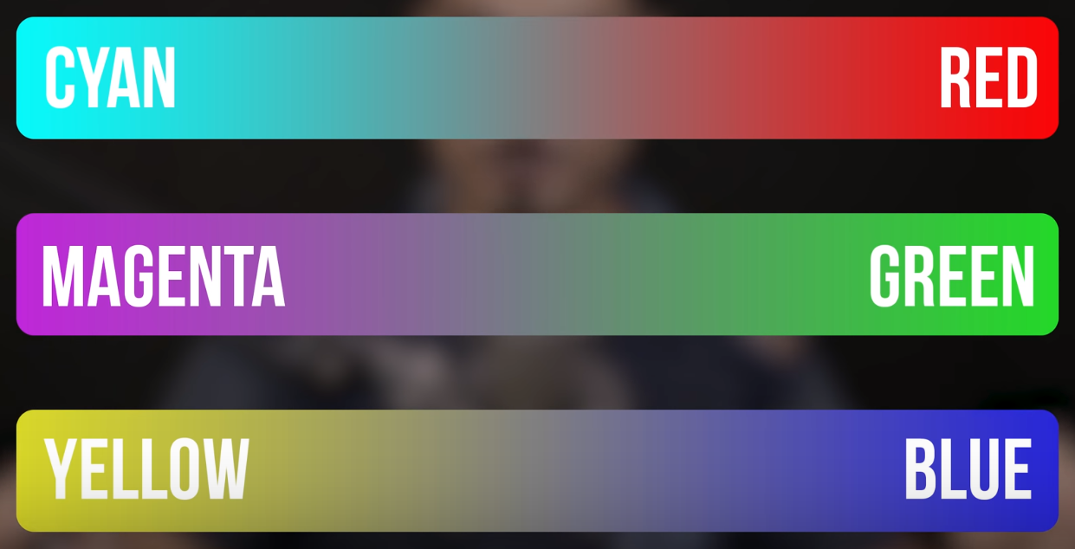
Competing Color Channels
To Add Subtract
Cyan Red
Magenta Green
Yellow Blue
Red Cyan
Green Magenta
Blue Yellow

Slide 12
Competing Colors
Red 255,0,0 Cyan 0,255,255 Note: Editing in RGB has
Green 0,255,0 Magenta 255,0,255 no effect on color -
Blue 0,0,255 Yellow 255,255,0 only effects luminosity of pixel
What is the RGB for Gray?
256x256x256 = 1,677,212 color combinations

Slide 13
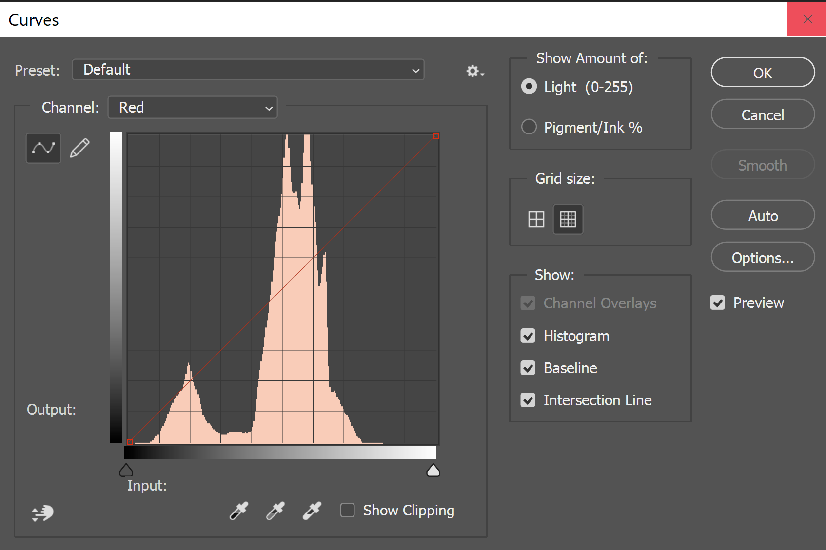
Curves Red Channel
Pull up to add red
Pull down to subtract red
(add cyan)

Slide 14
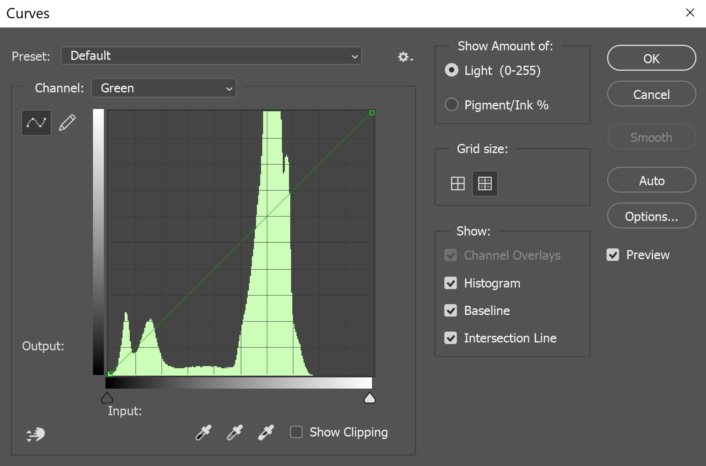
Curves Green Channel
Pull down to subtract green (add magenta)
Pull up to add green

Slide 15
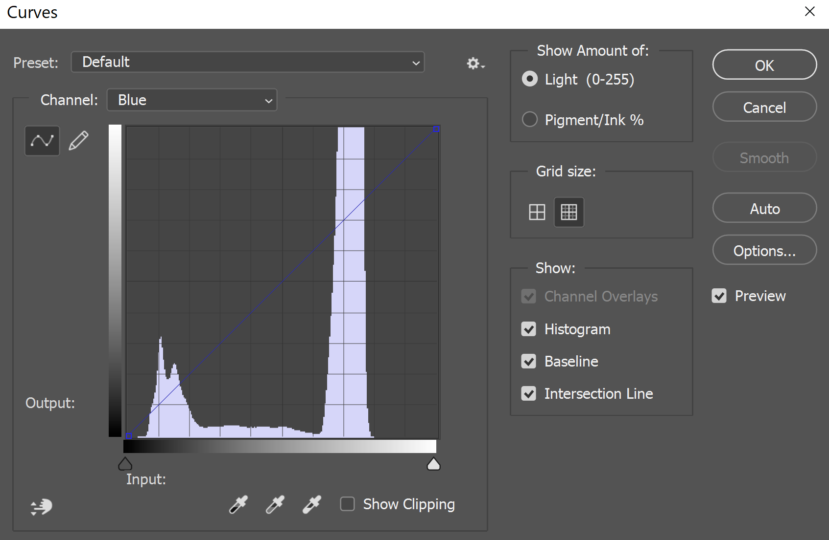
Curves Blue Channel
Pull up to add blue
Pull down to subtract blue (add yellow)

Slide 16
Using the Eyedroppers to Set a B/G/W Point
Black, Gray, and White Points are Obvious
Use Info Panel to verify
Threshold Adjustment Layer with Color Sampler Tool
Using Sliders
Using Sliders with Alt

Slide 17
Finding the Gray Point
Open a color photo
Create a blank layer
Fill blank layer with 50% gray (Shift F5)
Change blend mode to Difference
Create Threshold Adjustment Layer
Click on layer thumbnail (not the mask)
Click on Properties panel
Move slider to left
Slowly move slider to right
First black area is the gray point
Mark with Color Sampler (Find with “I”)
Delete or hide 50% gray and threshold layer
Click on original image
Bring up Curves Dialog (Ctrl M)
Select gray eye dropper
Click on Color Sampler point to set gray point

Slide 18
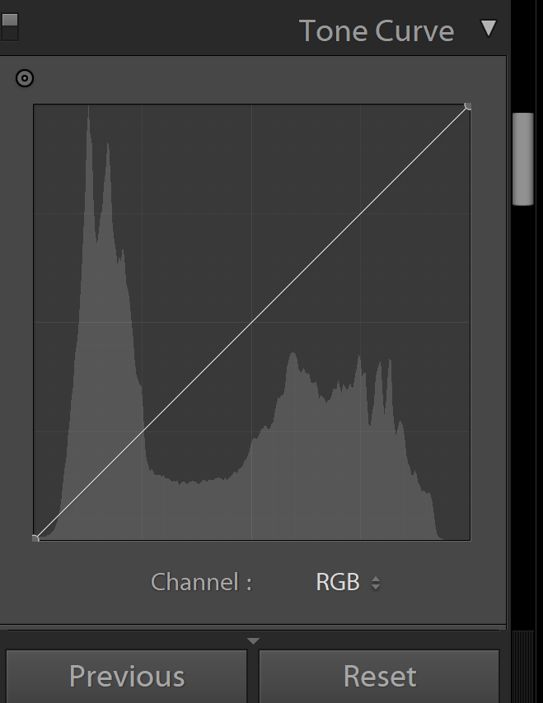
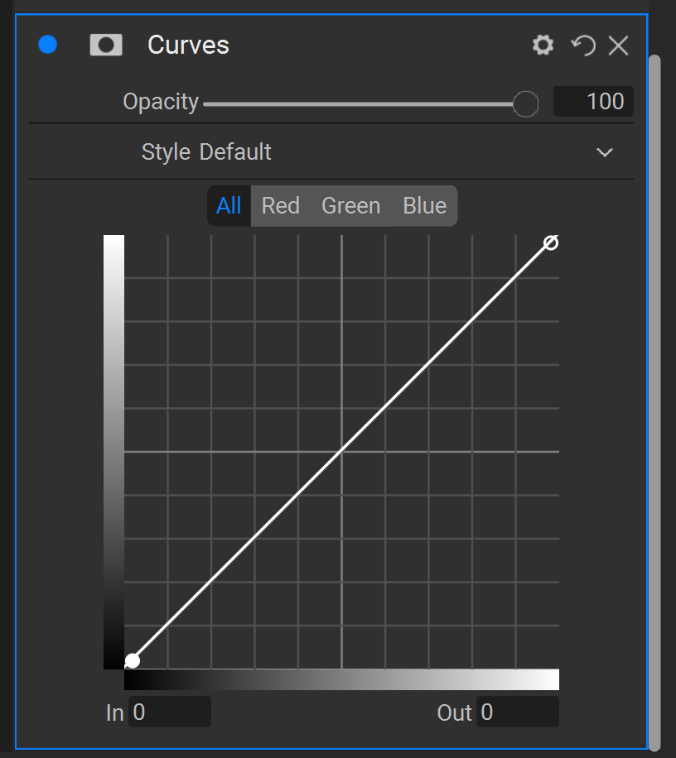
Lightroom On1 2020

